Slide 1


Build a community around your app
Jan-Christoph Borchardt @jancborchardt

Slide 2
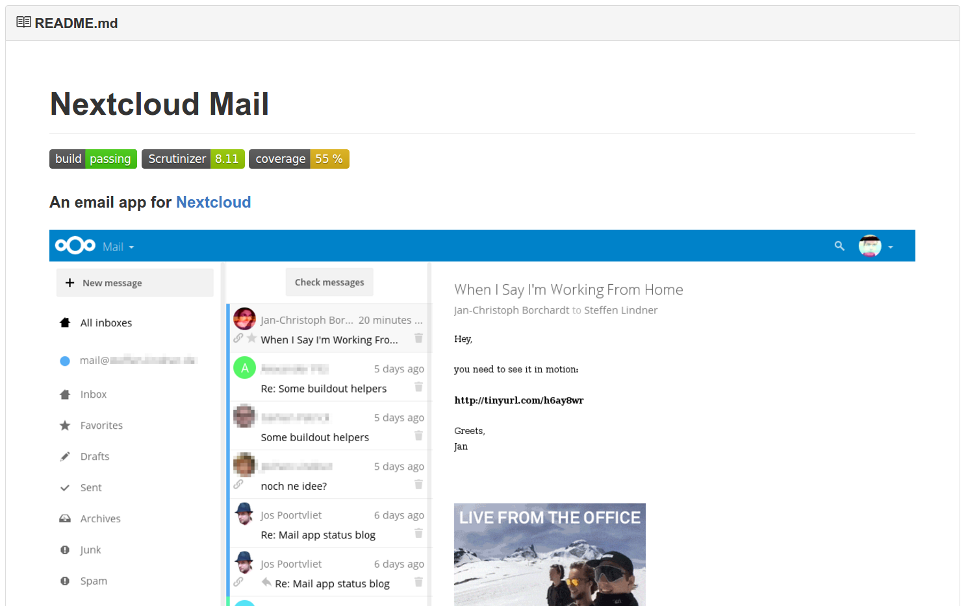
Be informative

Slide 3
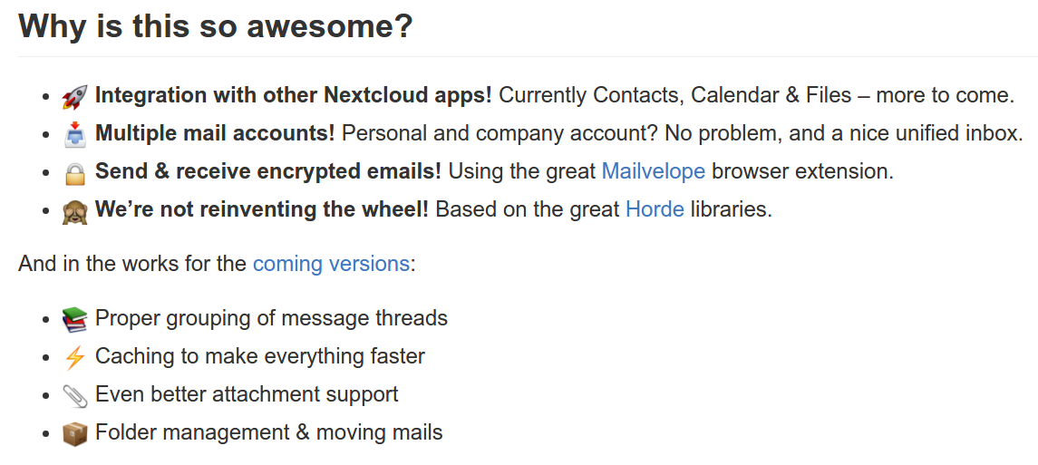
Be informative

Slide 4
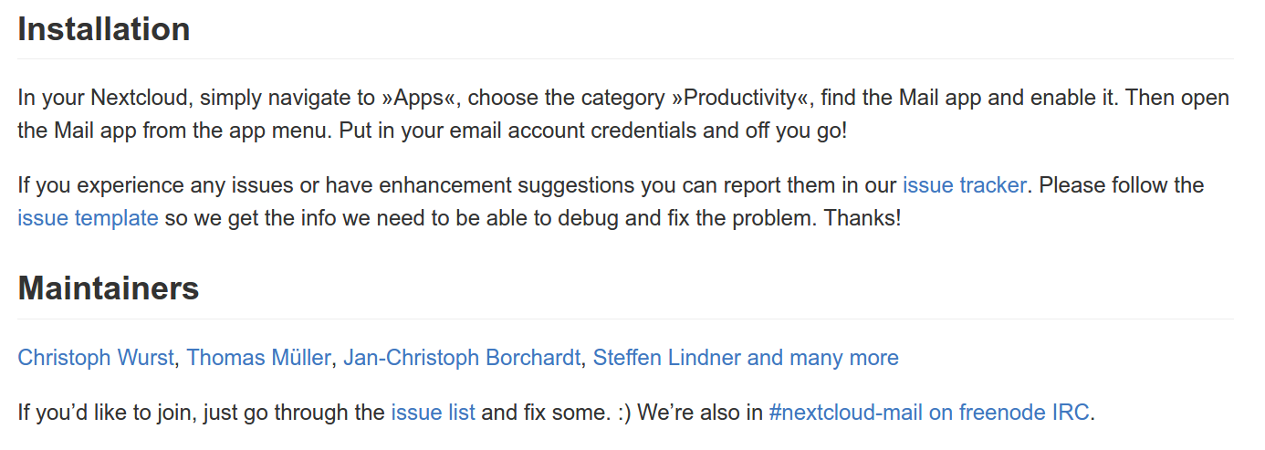
Be informative

Slide 5
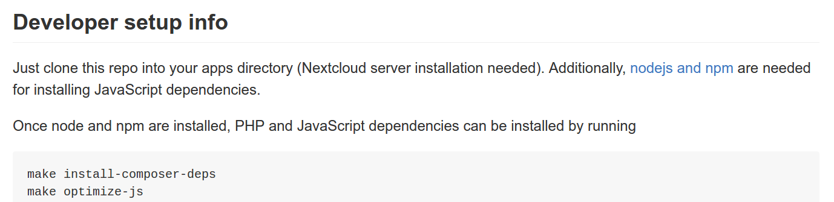
Be informative

Slide 6
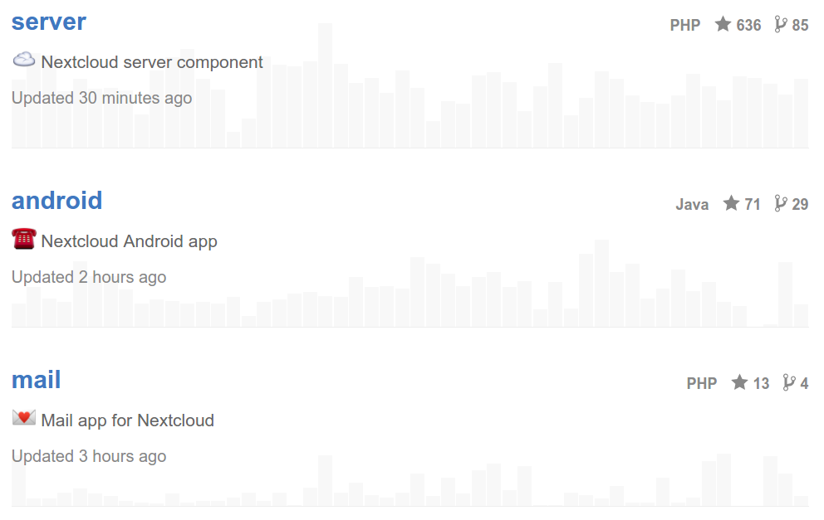
Be fun! :)

Slide 7
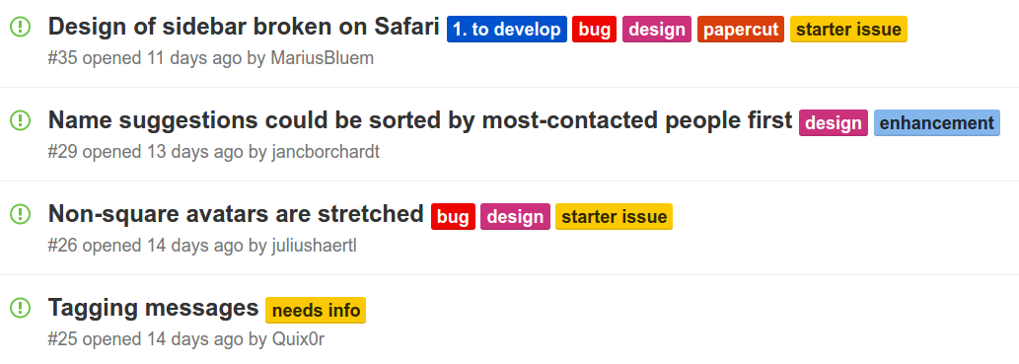
Be inclusive
starter issue

Slide 8
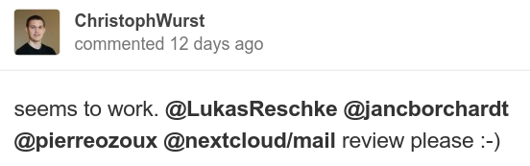
Be inclusive
@mention

Slide 9
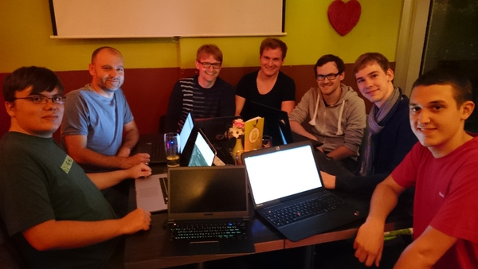
Do a meetup ;)

Slide 10
Informative, inclusive and fun! :)

